Slide 1
Introduction to Computer Course COM 1012
Introduction to Computer

Slide 2
What is Computer?
A computer is an electronic device that manipulates information, or data.
It has the ability to store, retrieve, and process data.
Also called processor. An electronic machine that accepts data, processes it according to specific instructions and provides the results as new information.
Data
Process
Information

Slide 3
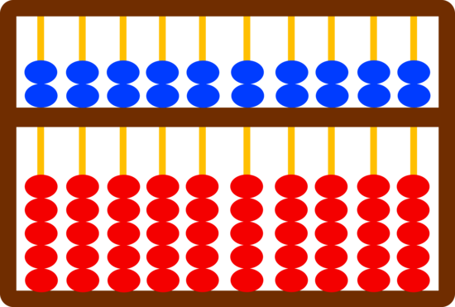
History of Computer
Abacus
Ancient Counting Machine.
Performing Arithmetic Calculations.
Invented in 3000 B.C by Babylonians.

Slide 4
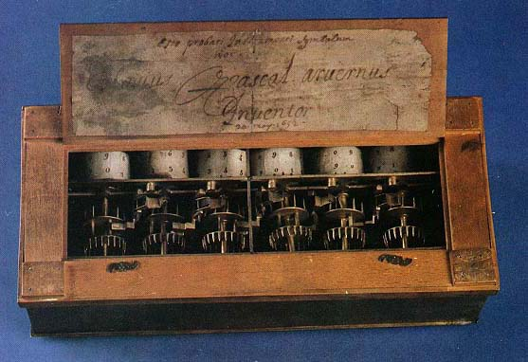
History of Computer
Pascaline
Performs addition and subtraction.
Opened up with gears and cylinders which rotated to show the numerical results.
Invented by Blaise Pascal.

Slide 5
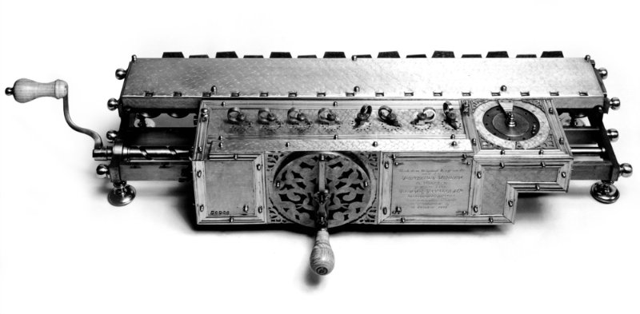
History of Computer
Stepped Reckoner
Leibniz invented calculating machine which he called Stepped Reckoner.
Has fluted drums with ten flutes arranged around their circumference.
Uses decimal number systems.
The device is capable of adding subtracting, multiplying, dividing and extracting roots.

Slide 6
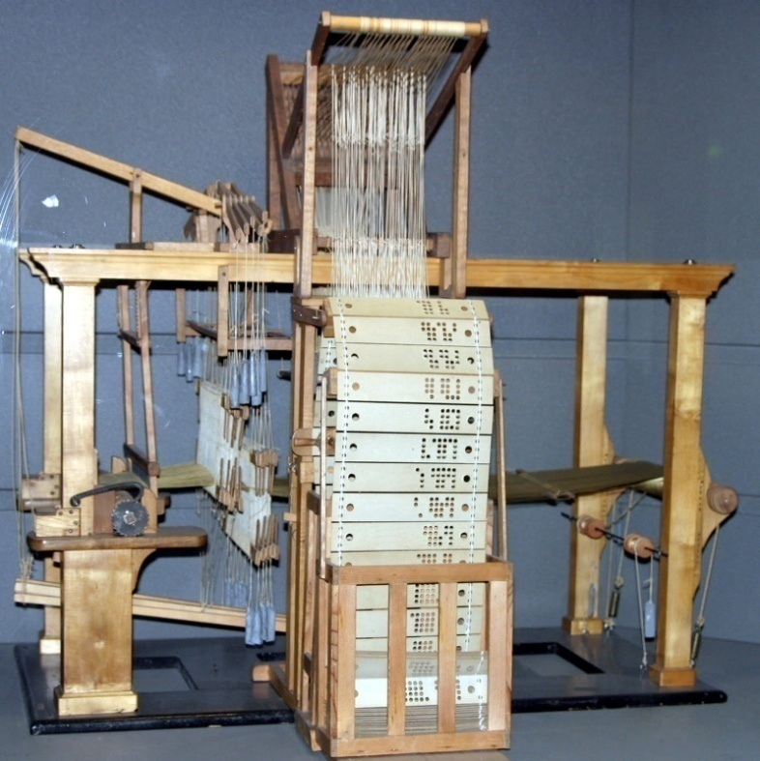
History of Computer
Jacquard’s Loom
Developed by Joseph-Marie Jacquard.
Loom worked by using wooden punched cards.

Slide 7
History of Computer
Difference Engine
Designed by Charles Babbage (known as ‘father of computer’).
The machine intended to solve table of numbers such as logarithm tables.
Calculating 20 decimal capacity of solving mathematical problems.
Analytical Engine
Again, Charles Babbage conceived a new machine, called Analytical Engine.
Punched card technology was used.
Capable of performing mathematical calculations, storing information by using punched cards.

Slide 8
History of Computer
Mark 1
Built by a team from IBM and Harvard University.
Used mechanical telephone switches to store information.
Accepts data on punched cards, processed it and output the new data.
ENIAC (Electronic Numerical Integrator and Computer)
First electronic general-purpose computer.
1000X faster than MARK 1 but drew a lot of power.
MARK 1: 5 additions/sec ENIAC: 5000 additions/sec

Slide 9
History of Computer
EDVAC (Electronic Discrete Variable Automatic Computer)
Used binary number system.
multipurpose computer.
First stored program computer.
UNIVAC (Universal Automatic Calculator)
an electrical computer containing thousands of vacuum tubes that utilizes punch cards and switches for inputting data and punch cards for outputting and storing data.

Slide 10
Two Inventions that changed the way computers are built!
Transistors
Invention of the modern era.
Smaller, faster and don’t need to warm up.
Integrated Circuit (IC)
Contains 3.1 million transistors in 1.5 inch square.
Smaller, faster, cheaper and more reliable than transistors.
Minicomputers were developed at this time.
Terminals replaced punched cards for data entry and disk packs became popular for secondary storage.

Slide 11
Parts of Computer
Computer
a
b
c
Hardware
Software
Procedure
Data
People
d
e

Slide 12
Hardware
Hardware refers to the actual machinery that makes up a Computer System.
For Example
Keyboard, Mouse, Joystick, Printer, Monitor

Slide 13
Software
Software refers to computer programs.
Software is a program that enables a computer to perform a specific task.
This includes application software such as a word processor, which enables a user to perform a task, and system software such as an operating system, which enables other software to run properly.

Slide 14
Procedure
Procedures are the steps that you must follow to accomplish a specific computer-related task.

Slide 15
Data
Data consists of raw facts and figures.
Computer process data is called “information”.
Data are any numbers, or text that can be processed by a computer.

Slide 16
People
People are the computer operators, also known as users or end user.

Slide 17
Characteristics of Computer
Speed
Accuracy
Diligence
Versatility
Power of Remembering
No I.Q
No Feeling

Slide 18
Classification of Computer
Computer
By Types
By Purpose
By size

Slide 19
Classified By Type
By Type
Analog
Digital
Hybrid

Slide 20
Analog Computers
The computers which provide us continuous information are called analog computers.
OR
A computer in which numerical data are represented by measurable physical variables, such as electrical voltage.

Slide 21
Digital Computers
The computers which present physical quantities with the help of symbols or numbers and provide us discrete information are called digital computers.
Usually in the binary number system.

Slide 22
Hybrid Computers
A computer designed to handle both analog and digital data.
A digital computer that accepts analog signals, converts them to digital and processes them in digital form.
Hybrid computer has the speed of analog and the accuracy of digital computer.

Slide 23
Classified By Purpose
By Purpose
General
Special

Slide 24
Special Purpose Computers
As the name states, a Special-Purpose Computer are designed to be task specific and most of the times their job is to solve one particular problem.

Slide 25
General Purpose Computers
Refers to computers that follow instructions, thus virtually all computers from micro to mainframe are general purpose.

Slide 26
Classified By Size
By Size
Micro
Mainframe
Super

Slide 27
Micro Computers
The term microcomputer is generally synonymous with personal computer (PC), or a computer that depends on a microprocessor.
Microcomputers are designed to be used by individuals, whether in the form of PCs, or notebook computers.

Slide 28
Mainframe Computers
A very large and expensive computer capable of supporting hundreds, or even thousands, of users simultaneously.
In some ways, mainframes are more powerful than supercomputers because they support more simultaneous programs. But supercomputers can execute a single program faster than a mainframe.

Slide 29
Super Computers
The fastest type of computer.
Supercomputers are very expensive and are employed for specialized applications that require huge amounts of mathematical calculations.
The chief difference between a supercomputer and a mainframe is that a supercomputer channels all its power into executing a few programs as fast as possible, whereas a mainframe uses its power to execute many programs concurrently.

